Slide 1
Model-driven optimization of tensor computations
Rui Li, candidate exam
Notes:
click to next page

Slide 2
Contents
Motivation
Optimization of basic tensor operators on shared-memory architecture
Using model in deep learning compiler
Efficient distributed algorithm derivation - 2D convolution
Future work: Efficient distributed algorithm derivation - general computation
Notes:
our presentation includes:
...
click to next page

Slide 3
motivation
Tensor computation: core workloads of scientific computing & deep learning
Tensor contraction: computational chemistry, transformer
Convolution: convolutional neural networks
LU factorization: computational physics, circuit simulators
Research & industrial efforts of optimizing Tensor computations
Platforms: tensorflow, pytorch, TVM
Polyhedral compilers: pluto, ppcg, tiramisu
HPC libraries: MKL, OneDNN, CuDNN

Slide 4
motivation
Select from pre-defined representative high-performance implementations
HPC libraries: MKL, OneDNN, CuDNN
Platforms that call HPC libs: Tensorflow, Pytorch (default version)
Ask user to decide optimization parameter
Polyhedral compilers: pluto, tiramisu
Machine learning or heuristic guided auto-tunning
TVM, XLA, Tensor comprehension
Problem: Limited design space or huge tunning time

Slide 5
Motivation
Challenge: comprehensive, automatic, static-analysis based performance modeling and code optimization
Contribution: we propose a performance modeling idea that:
Comprehensively explore the design space of basic tensor operators: contraction, convolution
Enable offline tunning and significantly save auto-tunning time for deep learning compilers
Create a way of deriving efficient distributed tensor computations

Slide 6
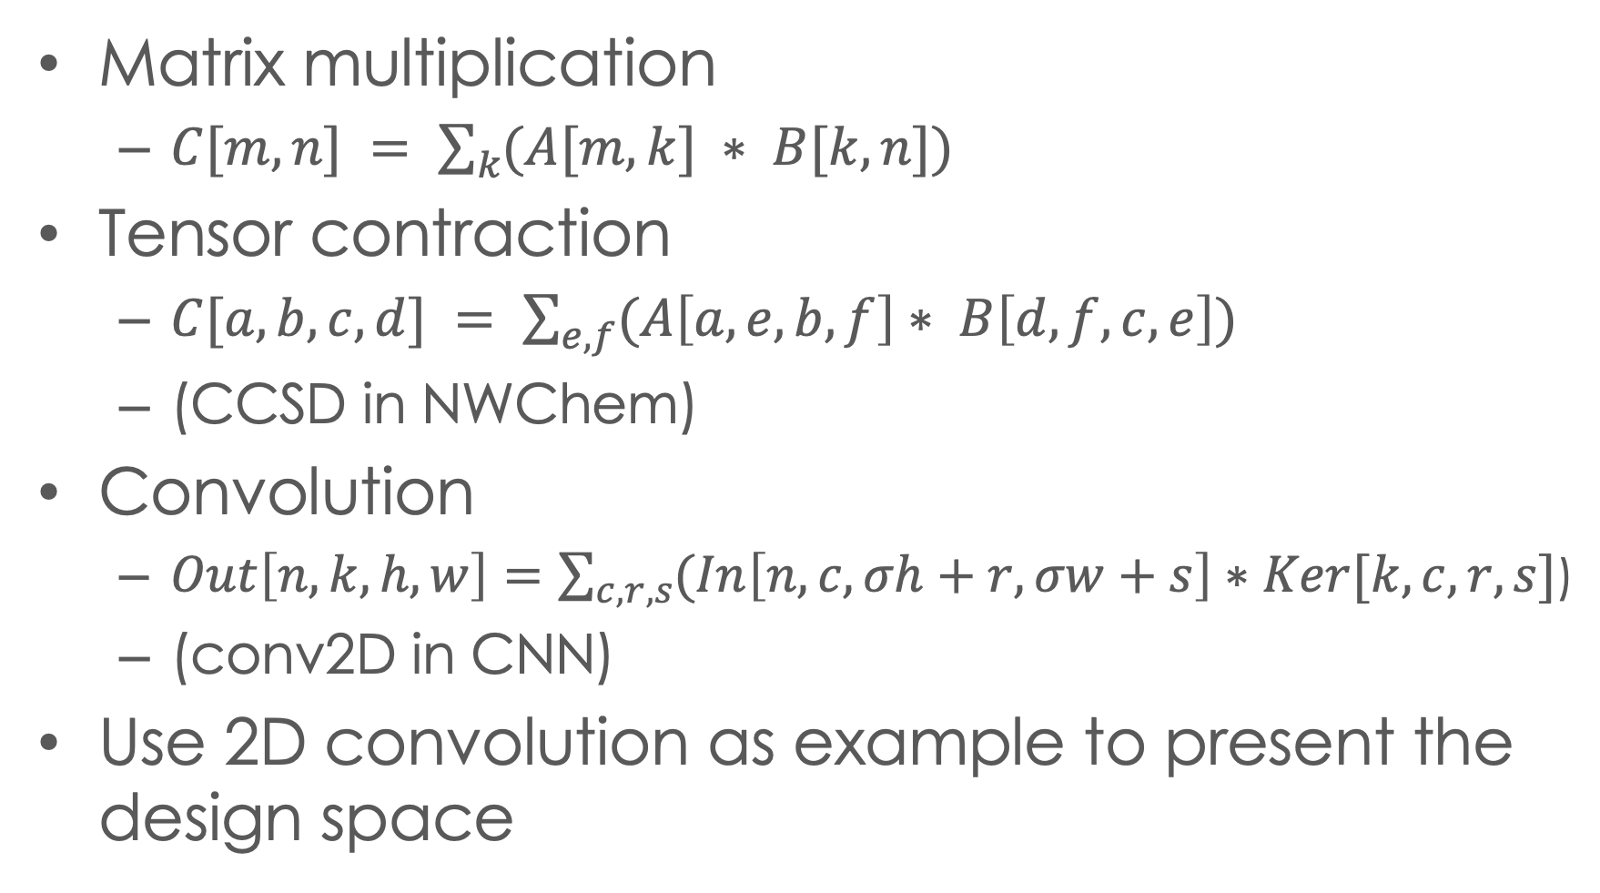
optimization of basic tensor operators
Matrix multiplication
$C[m,n] = \sum_{k}{(A[m,k] ∗ B[k,n]\text{)} }$
Tensor contraction
$C[a,b,c,d] = \sum_{e,f}{(A\left[a,e,b,f\right]∗ B\left[d,f,c,e\right])}$
(CCSD in NWChem)
Convolution
$Out\left[n,k,h,w\right]=\sum_{c,r,s}{(In\left[n,c, σh+r, σw+s\right]∗Ker[k,c,r,s}]\text{)}$
(conv2D in CNN)
Use 2D convolution as example to present the design space

Slide 7
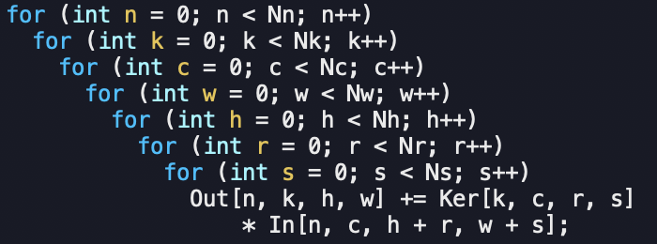
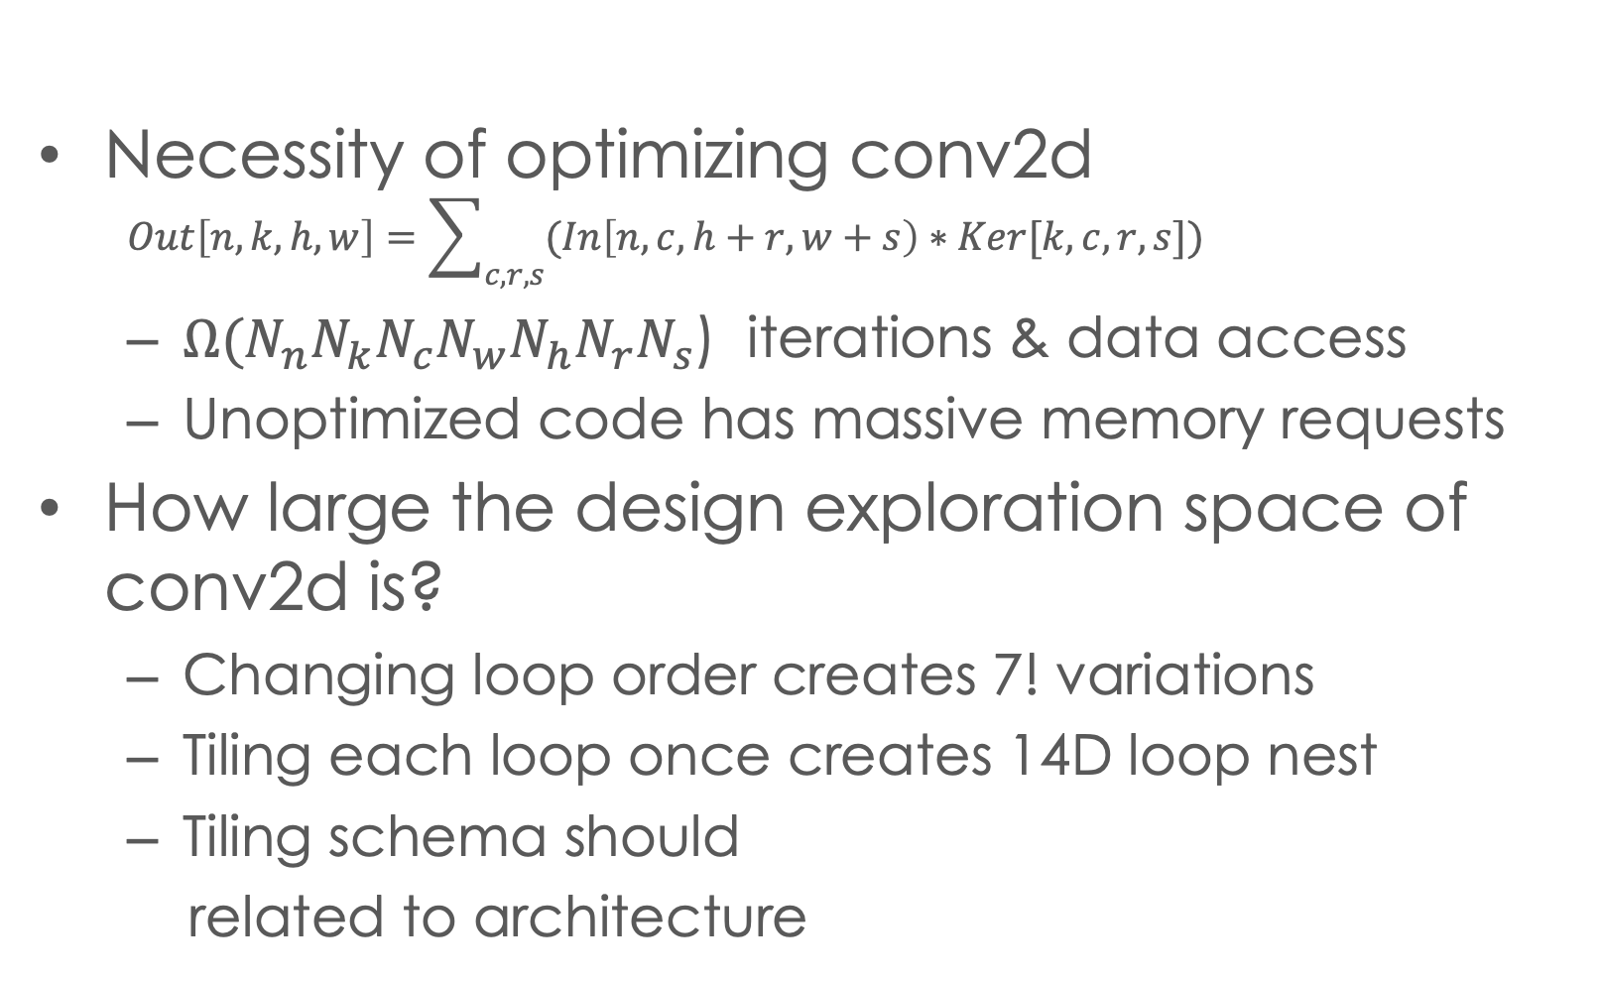
Conv2d design space
Necessity of optimizing conv2d
$$Out\left[n,k,h,w\right]=\sum_{c,r,s}{(In\left[n,c,h+r,w+s\right)∗Ker[k,c,r,s}])$$
${Ω(N}_{n}N_{k}N_{c}N_{w}N_{h}N_{r}N_{s}$) iterations & data access
Unoptimized code has massive memory requests
How large the design exploration space of conv2d is?
Changing loop order creates 7! variations
Tiling each loop once creates 14D loop nest
Tiling schema should
related to architecture
Notes:
( and we'll demon why not recommend this unopt ver)
the 7-d loop creates massive..
..
Now, to find a way to optimize this code, an important qeustion is: how large is the design space of the opti..
we consider 2 tech
1. repermu, 2. tiling
howver this is not enough, because the loop tiling structure should match the arch
We will use an example to show the full design space of 2-lv-cache.

Slide 8
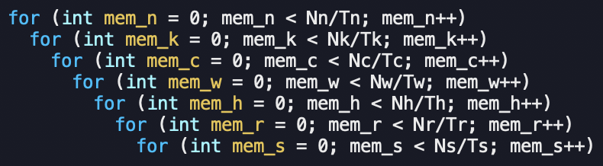
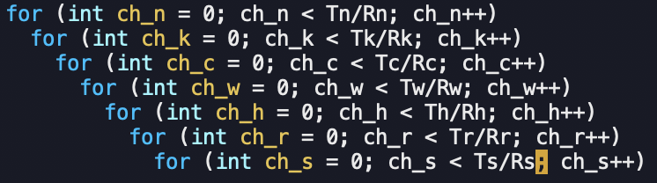
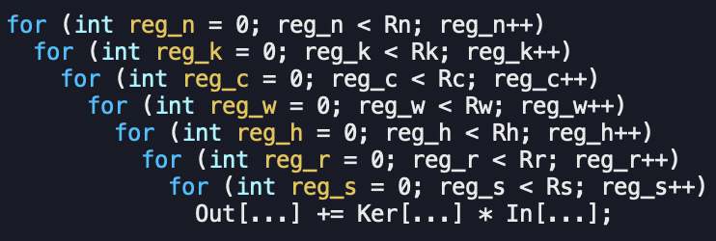
Conv2d design space
Design space exploration of 2-level hierarchy
Memory
7! Permutations
7 tile-size vars
Data movement
Loop order & tile-sizes decide data movement volume between memory and cache
Cache
7! Permutations
7 tile-size vars
Data movement
Loop order & tile-sizes decide data movement volume between cache and register
register
Notes:
we have 2 lv cache, named, 1 lv mem.
for each lv we create..
go top to bottom
data covers.., # permus, # vars
register lv- nopermu because
conclude 2lv
generalize this to get description of main challenge

Slide 9
System overview
Stage 1: Modeling & pruning
Modeling data volume in analytical expression
Pruning to eliminate design space explosion
Stage 2: Solving machinery
Find the solution of the modelled problem
Stage 3: Code generation
Parallelism, SIMD, etc.
Notes:
our can be summarized as 3 stage
..
we will starts from intro our statg 1

Slide 10
data volume Modle: Matmul example
Spill out
Tk
Not in cache, reload
Atile
Atile
Ctile
A
C
Ti
Ctile
For oi = 0:Ni:Ti
For oj = 0:Nj:Tj
For ok = 0:Nk:Tk
For pi = 0:Ti:1
For pj = 0:Tj:1
For pk = 0:Tk:1
C[oi+pi, oj+pj] +=
A[oi+pi, ok+pk]*
B[oj+pj, ok+pk];
Atile
Atile
Ctile
Ctile
i
Dv==TiTj+TiNk+TjNk
Dv=NiNj+NiNk*Nj/Tj+NjNk*Ni/Ti
k
Tj
j
B
Btile
Btile
Tk
k
Not in cache, reload
Dv=TiNj+TiNk*Nj/Tj+NjNk
Dv=TiTj+TiTk+TjTk
Btile
Btile
Spill out
Ni, Nj, Nk larger than cache capacity
Notes:
we use a matmul example to demo
left is, right is , assumption is
we start analysis from point loops
...
We can apply this idea to conv2d op

Slide 11

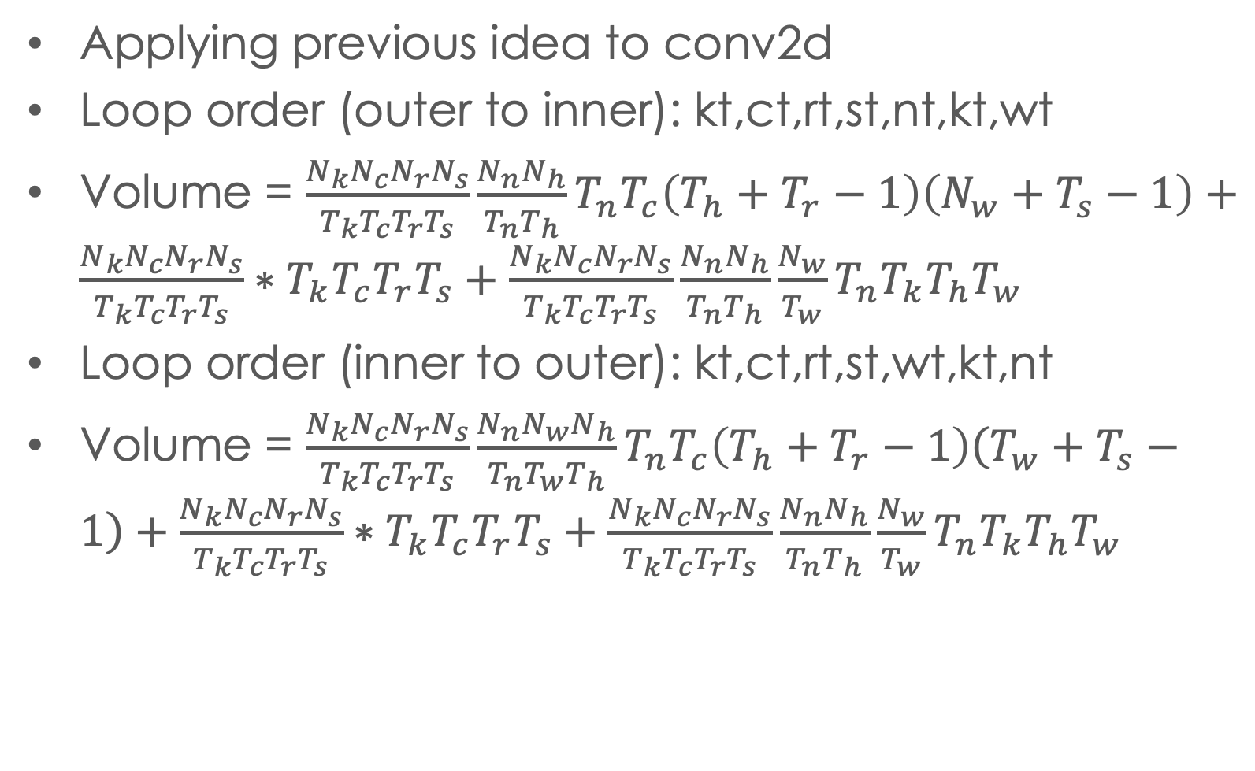
Pruning volume expression
Applying previous idea to conv2d
Loop order (outer to inner): kt,ct,rt,st,nt,kt,wt
Volume = ${\frac{N_{k}N_{c}N_{r}N_{s}}{T_{k}T_{c}T_{r}T_{s}}\frac{N_{n}N_{h}}{T_{n}T_{h}}T}_{n}T_{c}\left(T_{h}+T_{r}−1\right)\left(N_{w}+T_{s}−1\right)+\frac{N_{k}N_{c}N_{r}N_{s}}{T_{k}T_{c}T_{r}T_{s}}∗T_{k}T_{c}T_{r}T_{s}+\frac{N_{k}N_{c}N_{r}N_{s}}{T_{k}T_{c}T_{r}T_{s}}\frac{N_{n}N_{h}}{T_{n}T_{h}}\frac{N_{w}}{T_{w}}T_{n}T_{k}T_{h}T_{w}$
Loop order (inner to outer): kt,ct,rt,st,wt,kt,nt
Volume = ${\frac{N_{k}N_{c}N_{r}N_{s}}{T_{k}T_{c}T_{r}T_{s}}\frac{N_{n}N_{w}N_{h}}{T_{n}T_{w}T_{h}}T}_{n}T_{c}\left(T_{h}+T_{r}−1\right)\left(T_{w}+T_{s}−1\right)+\frac{N_{k}N_{c}N_{r}N_{s}}{T_{k}T_{c}T_{r}T_{s}}∗T_{k}T_{c}T_{r}T_{s}+\frac{N_{k}N_{c}N_{r}N_{s}}{T_{k}T_{c}T_{r}T_{s}}\frac{N_{n}N_{h}}{T_{n}T_{h}}\frac{N_{w}}{T_{w}}T_{n}T_{k}T_{h}T_{w}$
Loop order < kt,ct,rt,st,nt,kt,wt >
is always better than < kt,ct,rt,st,wt,kt,nt >
$$\left(N_{w}+T_{s}−1\right)≤\frac{N_{w}}{T_{w}}(T_{w}+T_{s}−1)$$
Notes:
for a given loop permu, we can infer.
for another... we can also
now if we compare these 2 expr
...
we further simplif the compariosn and obtain..
..
By use this tech, we conclude that

Slide 12
Pruning results
All 7! permutations cannot be better than the following 8 equivalent classes of permutations
⟨{kt, ct, rt, st }, {nt, ht }, wt⟩
⟨{nt, kt, ht, wt }, {ct,rt }, st⟩
⟨{nt,ct, ht, rt, st }, wt, kt⟩
⟨{nt,ct, ht, wt, rt }, st, kt⟩
⟨{kt, ct, rt, st }, {nt, wt }, ht⟩
⟨{nt, kt, ht, wt }, {ct, st }, rt⟩
⟨{nt, ct, wt, rt, st }, ht, kt⟩
⟨{nt, ct, ht, wt, st },rt, kt⟩
(from left to right is from outer loop to inner)
Repermute loop order inside curly brackets does not change data volume expression
Notes:
we need to mention in our slides, the curly bracket indicates repermuting iterators inside
Till here we have demon ..
we will move to how to formalize the optimization problem using the model and how to solve it

Slide 13
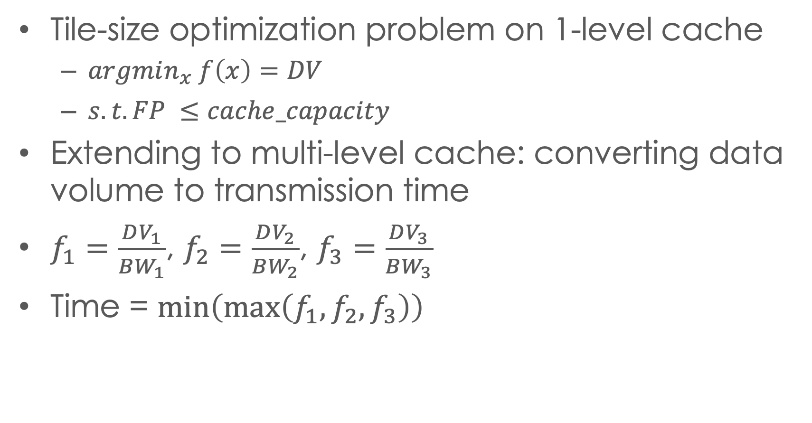
Solving machinery
Tile-size optimization problem on 1-level cache
$argmin_{x} f\left(x\right)=DV$
$s.t. FP ≤cache_capacity$
Extending to multi-level cache: converting data volume to transmission time
$f_{1}=\frac{DV_{1}}{BW_{1}}$, $f_{2}=\frac{DV_{2}}{BW_{2}}$, $f_{3}=\frac{DV_{3}}{BW_{3}}$
Time = $\min\left(\max\left(f_{1},f_{2},f_{3}\right)\right)$
Notes:
we can plot those f to get better view.
the perf of system is always limited by the slowest component.
We will then move to the nxet stage to briefly discuss how to codegen

Slide 14
Code generation
L2 tile
L2 tile
Shared-memory parallelism
Divide the shared-cache
Apply time-based modeling
micro-kernel
guarantees instruction-level optimization
Emits assembly code to avoid unexpected compiler interference
Time L3 to L2
L3 tile
Per-core L3 tile
Per-core L3 tile
Time memory to L3
memory
Notes:
there are sveral important factors, 1. parallel 2. use microkenerl to ensure the inst lv perf

Slide 15
Experiment Overview
Benchmarks:
conv2d from ResNet, MobileNet, and Yolo-9000
32 conv2ds in different shapes
Platforms:
8-cores i7-9700K with AVX2,
18-cores i9-10980XE with AVX512
Performance comparison
oneDNN: high-optimized library
AutoTVM: ML-based autotuning compiler
Mopt-1: best implementation found by model
Mopt-5: actual best implementation among the top-5 found by model

Slide 16
Experiment: performance comparison
Parallel conv2d performance comparison on Intel 8-core i7-9700K
Parallel conv2d performance comparison on Intel 18-core i9-10980XE

Slide 17
Using model in deep learning compiler
AutoTVM compiler use auto-tuning to evaluate the performance of different optimization
Huge time and resource consumption
Online tunning must be deployed on target machine
Extra difficulties for deployment
Next generation AutoTVM
Remove auto-tuning, use static-analysis based performance model to evaluate performance
Use idea in this proposal to model data movement
Other features included
Production project completed in internship in AWS SageMaker/TVM team

Slide 18
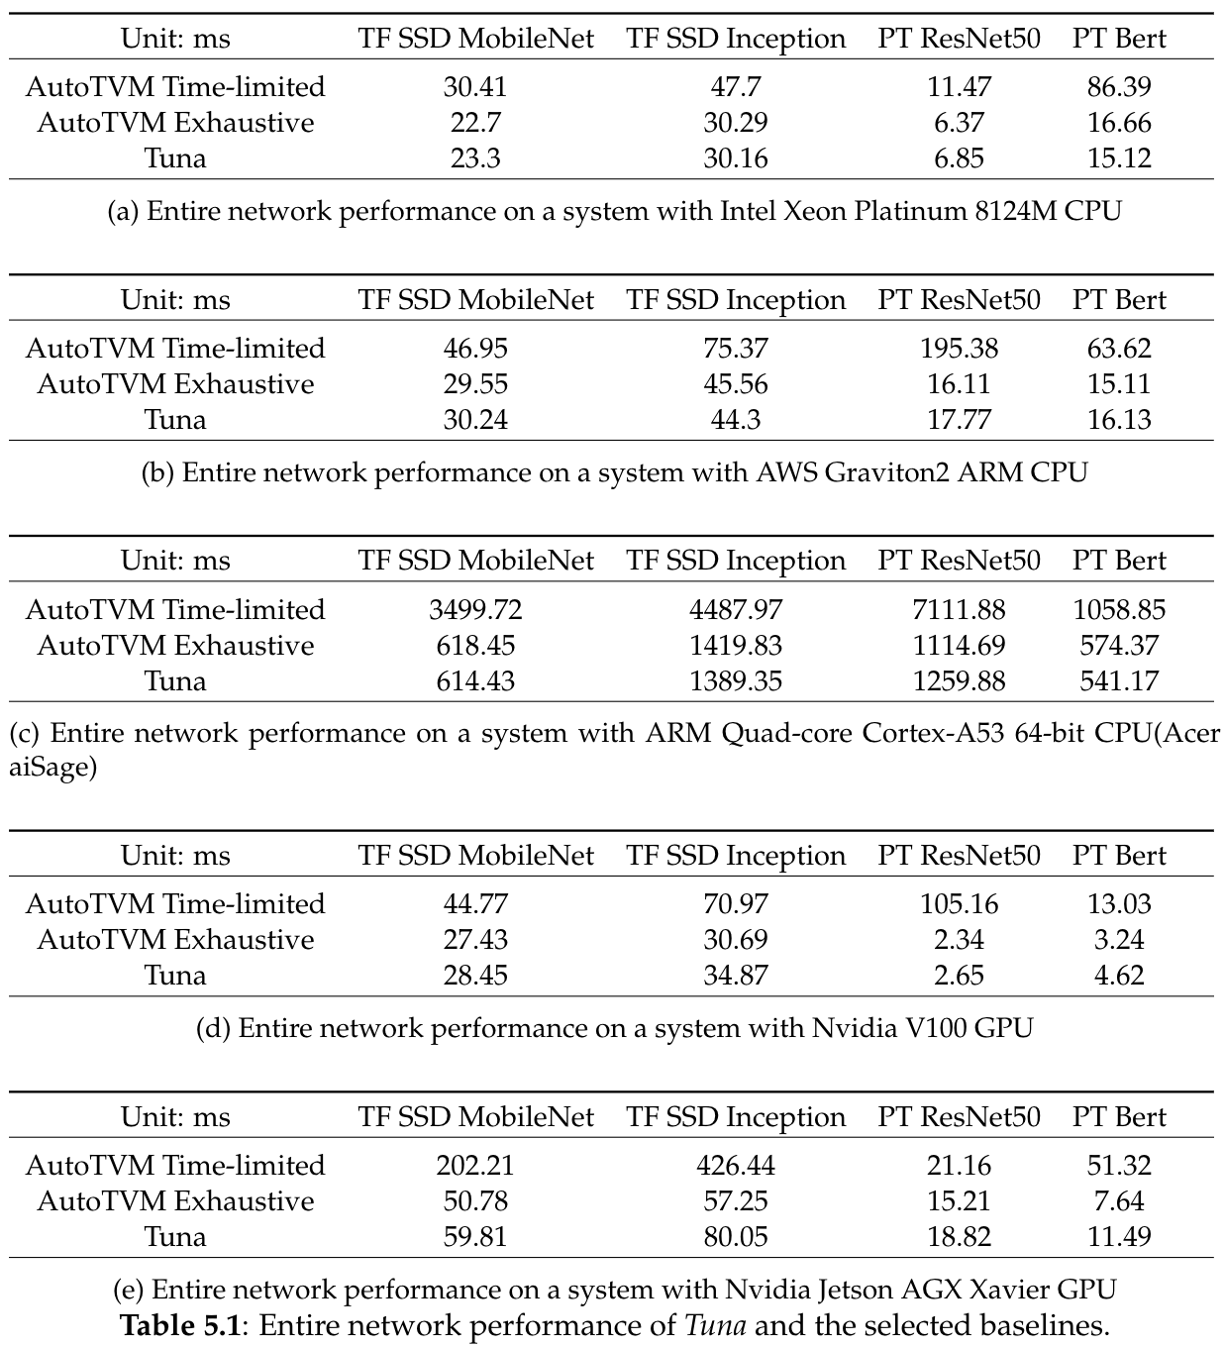
Using model in deep learning compiler
Table shows inference time
AutoTVM Time-limited: auto-tunning under time limitation
AutoTVM Exhaustive: exhaustively auto-tunning (time consumption shown in next page)
Tuna: model-driven TVM
1.3x ~ 5.7x faster than limited-time tuning, comparable with exhaustive tuning

Slide 19
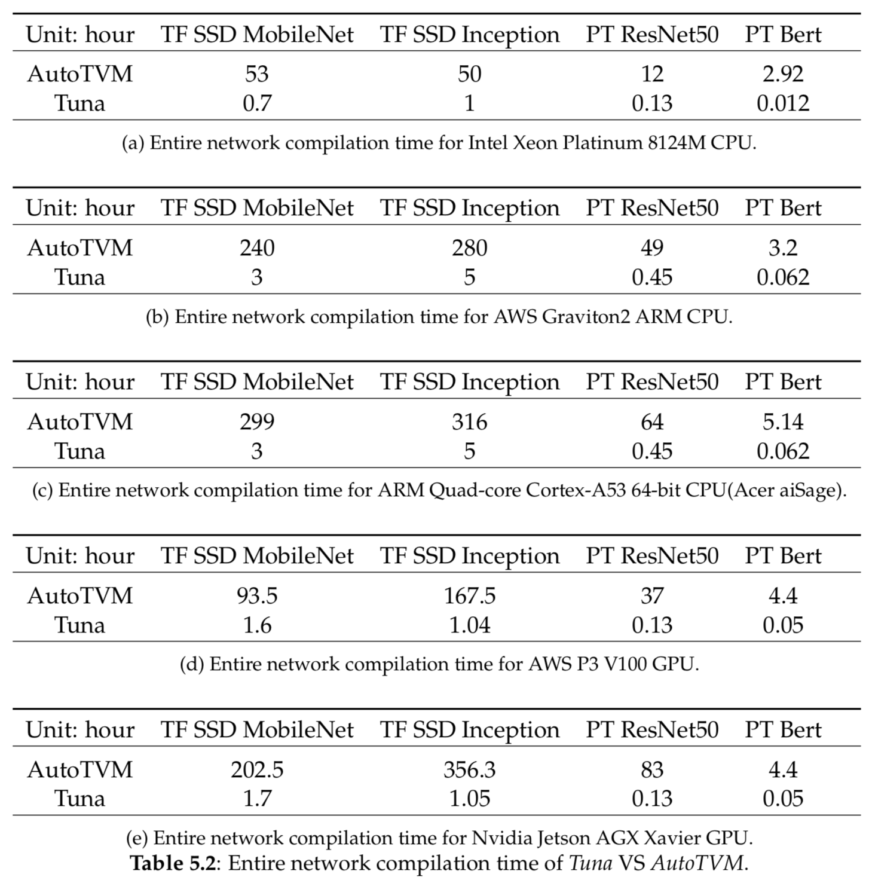
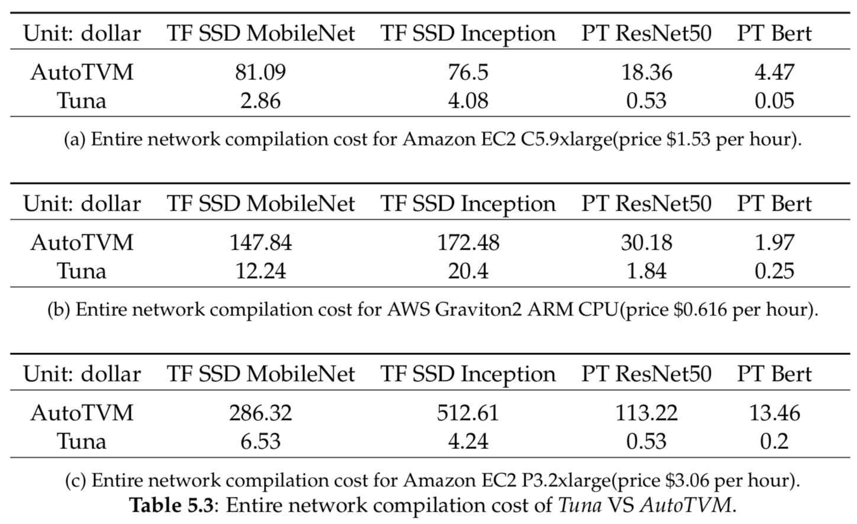
Using model in deep learning compiler
Tuning time comparison versus exhaustive auto-tuning
Always faster than limited-time tuning, comparable with exhaustive tuning
Accelerate tunning time >80x to find same efficient optimization
User save >95% expense for renting AWS EC2 instances in ML service

Slide 20
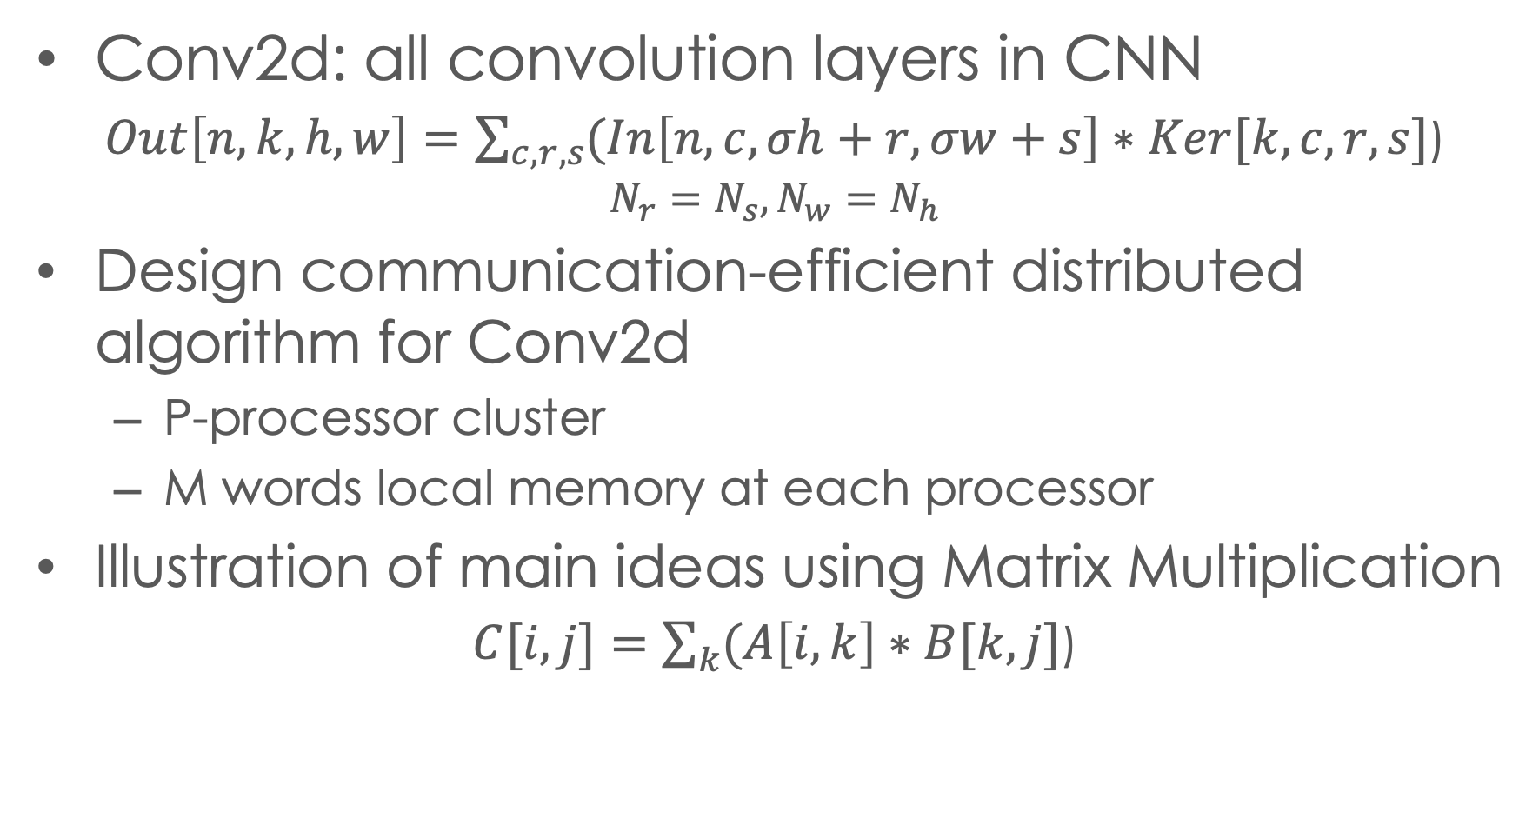
Efficient distributed algorithm derivation: conv2d
Conv2d: all convolution layers in CNN
$Out\left[n,k,h,w\right]=\sum_{c,r,s}{(In\left[n,c, σh+r, σw+s\right]∗Ker[k,c,r,s}]$)
$$N_{r}=N_{s}, N_{w}=N_{h}$$
Design communication-efficient distributed algorithm for Conv2d
P-processor cluster
M words local memory at each processor
Illustration of main ideas using Matrix Multiplication
$C[i,j]=\sum_{k}{(A\left[i,k\right]∗B[k,j}]$)
Notes:
2d conv is the most important op in cnn, the expr is shown
in this presentation, for illustration purpose we will assume the image and stencil are symmetric
Our goal is to design .. under given number of p and given local mem size
also for illustration, in the next slides, we will use matmul as a example to illustrate the main idea of paper. then we will breifly show the extension to 2d conv

Slide 21
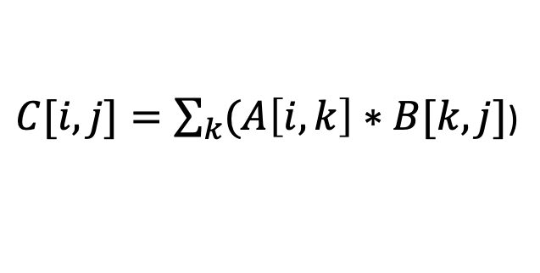
Overview
2-level tiling view of parallel algorithm on global memory
Define N, W, T
Tile size optimization problem construction under global memory assumption
Find W, T to reduce communication
Design distributed memory algorithm from the efficient global-memory solution
P0
P1
P2
P3
Problem range N
$C[i,j]=\sum_{k}{(A\left[i,k\right]∗B[k,j}]$)
C Tile
B Tile
A Tile
Local
tile T
P0 work
space W
Notes:
The overall apporoach can be summerized
at the beginning we'll construct
We'll then build ... under ..., s.t
And at the last step we'll use ... to
One the right we are showing the schemaThe first tiling level... The second tiling level..

Slide 22
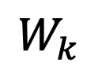

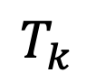
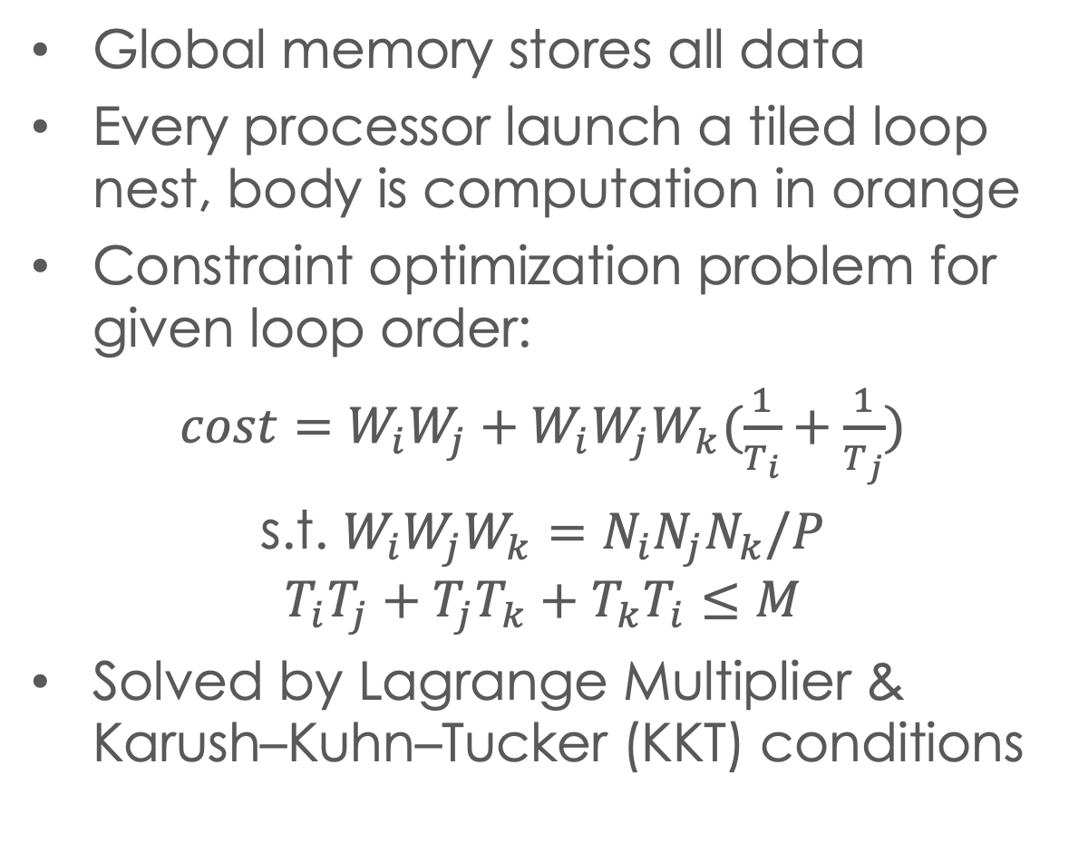
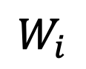

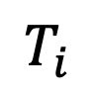
Systematic algorithm construction
Global memory stores all data
Every processor launch a tiled loop nest, body is computation in orange
Constraint optimization problem for given loop order:
$cost=W_{i}W_{j}+W_{i}W_{j}W_{k}(\frac{1}{T_{i}}+\frac{1}{T_{j}})$
s.t. $W_{i}W_{j}W_{k}=N_{i}N_{j}N_{k}/P$
$$T_{i}T_{j}+T_{j}T_{k}+T_{k}T_{i}≤M$$
Solved by Lagrange Multiplier & Karush–Kuhn–Tucker (KKT) conditions
$$T_{k}$$
Local
tile T
$$T_{i}$$
$$W_{i}$$
$$T_{j}$$
$$W_{k}$$
$$W_{j}$$
for tile_i..
for tile_j..
for tile_k..
do local tile T
Notes:
w'll then intro how to constr tile-size opt prob
Under the global memory assump, each proc will execute.... to iterate over the local work space W
The body of the tiled loop nest is T
with a fixed loop permutation, we can derive the expression of the data volume accessed from global memory.

Slide 23
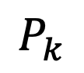
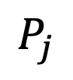
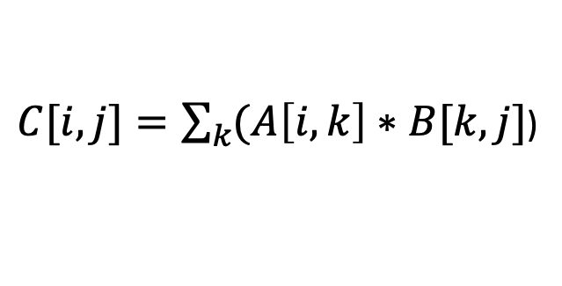
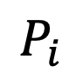
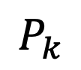
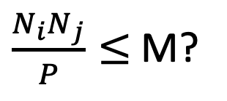

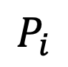
Matmul: Global solution
$\frac{N_{i}N_{j}}{P}≤$ M?
$C[i,j]=\sum_{k}{(A\left[i,k\right]∗B[k,j}]$)
Yes, 2.5D/3D
Pk>1
Local C not tiled
No, 2D
Pk=1
cost
2D
C Tile
C
$$P_{i}$$
2.5D
3D
$$P_{i}$$
$$P_{k}$$
$$P_{k}$$
M
$$P_{j}$$
$$P_{j}$$
Notes:
the structure of glb mem sol can be expressed by the figure.
When we don't have enough local mem, s.t the summation of all local mem is less or equal to tensor C, the sol we derived will not spread proc along k dim. This is equivalent to 2D
Otherwise ... the sol we direived will spread proc along all dim, and not tile the local C footprint. this is equivalent to 2.5D and 3D. And inside this branch, if the local memory is larger than some point, we will always reach 3D solution, otherwise it will stay with the 2.5d sol.
They all get derived from the solution of a single optimization problem
Till here we demo, we 'll then show how to construct distributed mem algo from here

Slide 24
Construct distributed memory algorithm
Global memory
Distributed memory
C0
B4
B5
C2
B4
B5
Same C
C
A4
A6
A5
A7
replicated
Same B
C0
B0
B1
C2
B0
B1
C
B0
broadcast
A0
A2
A0
B1
A1
A3
Nj
B2
B3
B2
B3
Nj
C1
C3
Same A
broadcast
A1
A0
A2
Nk
Nk
A1
A3
Ni
Ni
Notes:
each proc is executing a local tiled loop. the tile footprint of the first iter is shown in the figure. at the next iteration it will keep reuse Ctile and load new A,B tile from global mem
we can observe the proc along the k dim is using the same footprint of C, j-A, i-B.
based on the schedule we can create a dist alg as follows. we will replicate the FP of C along k, and we distribute A footprint along j, B along i. In this example, all proc at left side holds first half of B, and all pro at right side holds second half of B. So when the tiled loop exe on first half itertions, all proc on left will bcast data, ..
by doing that we can utilize tile size of glb mem sol to form a dist mem alg

Slide 25
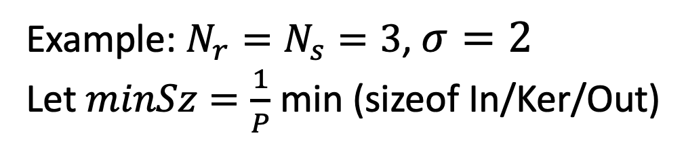
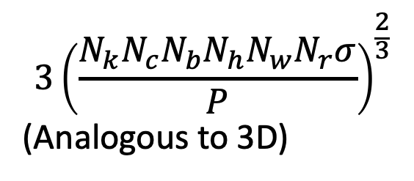
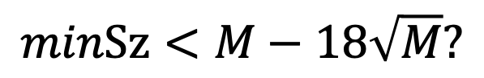
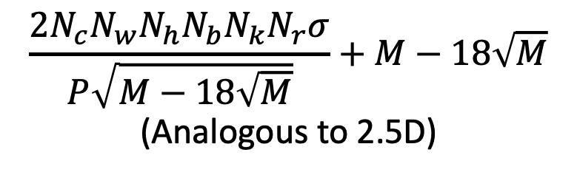
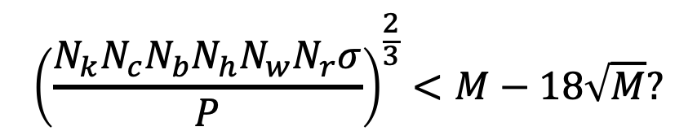
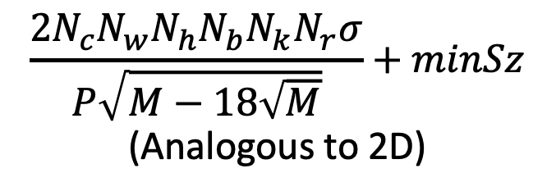
CNN: Global solution
cost
Example: $N_{r}=N_{s}=3$, $σ=2$
Let $minSz=\frac{1}{P}$ min (sizeof In/Ker/Out)
2D
$$minSz<M−18\sqrt{M}?$$
2.5D
3D
No
Yes
M
$$\frac{2N_{c}N_{w}N_{h}N_{b}N_{k}N_{r}σ}{P\sqrt{M−18\sqrt{M}}}+minSz$$
(Analogous to 2D)
$${\left(\frac{N_{k}N_{c}N_{b}N_{h}N_{w}N_{r}σ}{P}\right)}^{\frac{2}{3}}<M−18\sqrt{M}?$$
No
Yes
$$\frac{2N_{c}N_{w}N_{h}N_{b}N_{k}N_{r}σ}{P\sqrt{M−18\sqrt{M}}}+M−18\sqrt{M}$$
(Analogous to 2.5D)
$${3\left(\frac{N_{k}N_{c}N_{b}N_{h}N_{w}N_{r}σ}{P}\right)}^{\frac{2}{3}}$$
(Analogous to 3D)

Slide 26
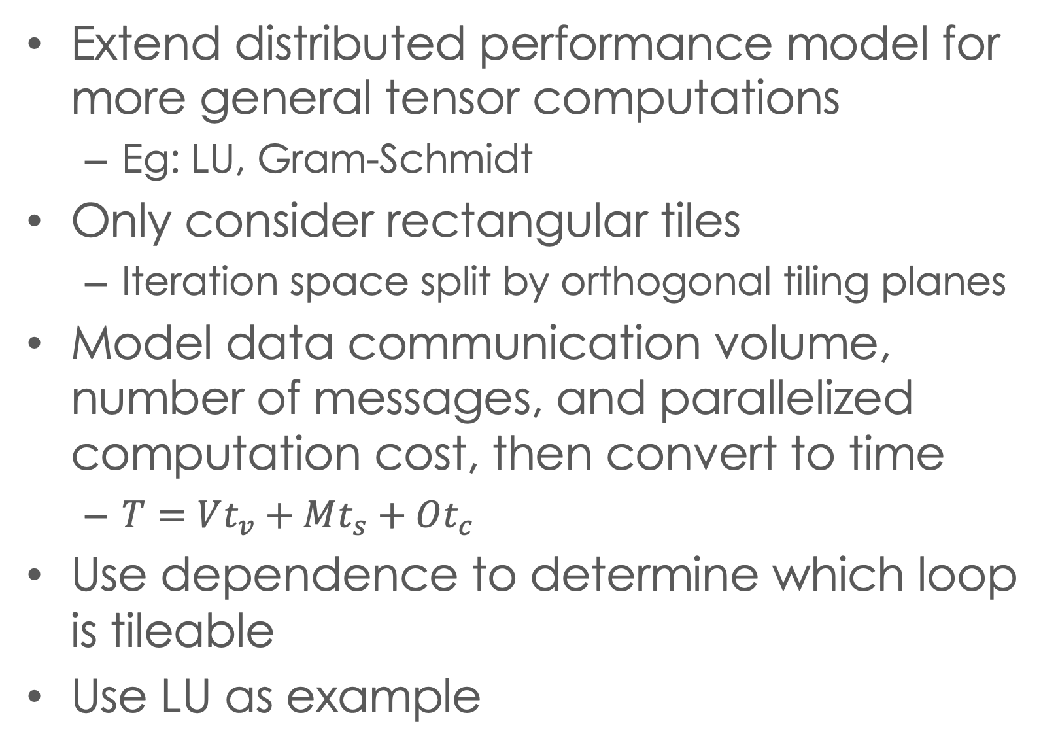
Future work
Extend distributed performance model for more general tensor computations
Eg: LU, Gram-Schmidt
Only consider rectangular tiles
Iteration space split by orthogonal tiling planes
Model data communication volume, number of messages, and parallelized computation cost, then convert to time
$T=Vt_{v}+Mt_{s}+Ot_{c}$
Use dependence to determine which loop is tileable
Use LU as example

Slide 27
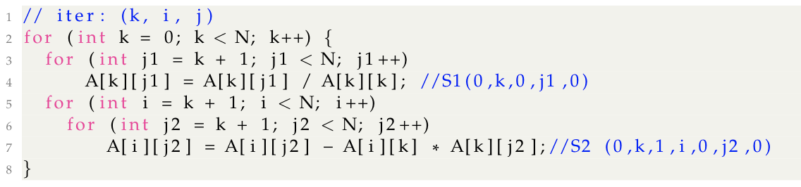
Future work: lu example
j
i
3 orthogonal tiling planes of 3D iteration space
Consider tile-level dependence
Across k tiling plane (blue) is sequential
k

Slide 28
LU Example
Intertile dependence, Front view
Inter-tile dependence of iteration subspace between adjacent k tiling plane
Execution order: green, purple, blue
Each tile is executed in parallel on several processors
8-processor
parallelization
example of blue tiles

Slide 29
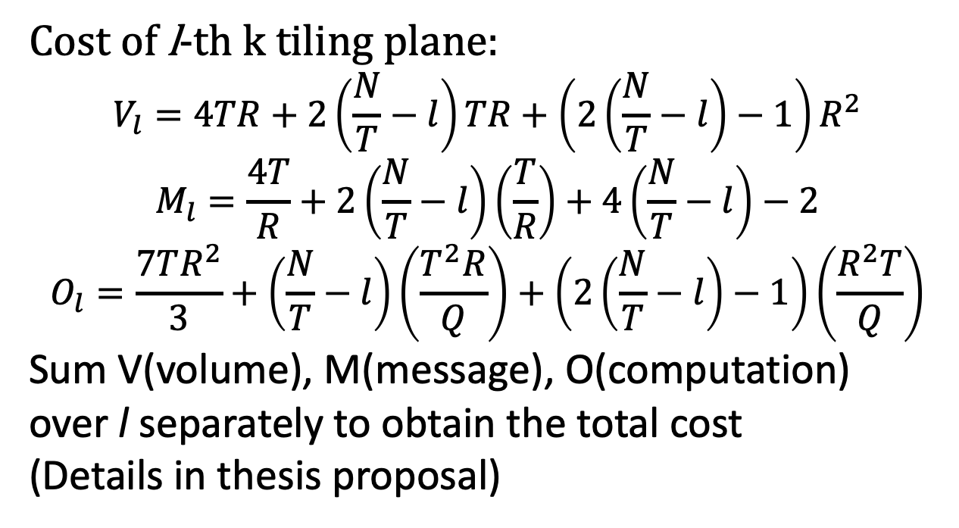
Performance model
Given the tiling schedule, model the cost as expression of tile size variable
T
Cost of l-th k tiling plane:
$$V_{l}=4TR+2\left(\frac{N}{T}−l\right)TR+\left(2\left(\frac{N}{T}−l\right)−1\right)R^{2}$$
$$M_{l}=\frac{4T}{R}+2\left(\frac{N}{T}−l\right)\left(\frac{T}{R}\right)+4\left(\frac{N}{T}−l\right)−2$$
$$O_{l}=\frac{7TR^{2}}{3}+\left(\frac{N}{T}−l\right)\left(\frac{T^{2}R}{Q}\right)+\left(2\left(\frac{N}{T}−l\right)−1\right)\left(\frac{R^{2}T}{Q}\right)$$
Sum V(volume), M(message), O(computation)
over l separately to obtain the total cost
(Details in thesis proposal)
R
T
R
l-th k tiling plane

Slide 30
Tileable loop detection
Determine which loops can be tiled by analyzing dependence information
Use time-stamp vector
Loop j is tileable if
For any S1(0,k,0,j1,0)->…-> S1(0,k’,0,j1’,0), j1’>=j1
For any S2(0,k,1,i,0,j2,0)->…->S2(0,k’,1,i’,0,j2’,0), ), j2’>=j2
… can be arbitrary statements
Under this criteria, LU is 3D tileable
Detail inference in thesis proposal

Slide 31
Thanks for listening
Questions ?

Slide 32

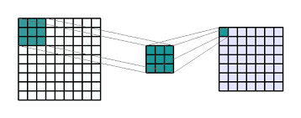
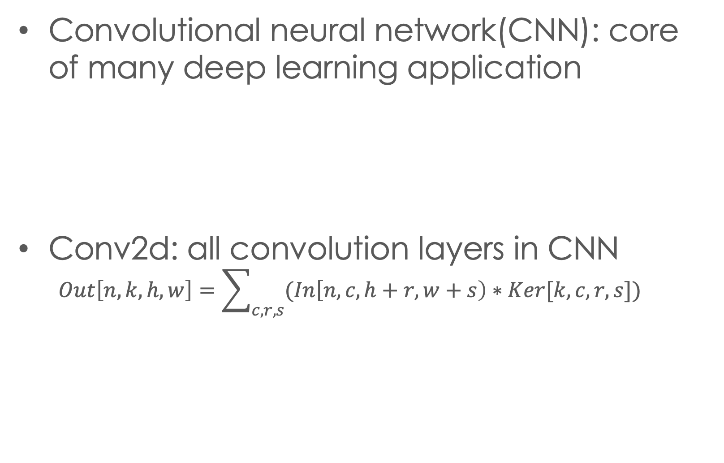
Motivation
Convolutional neural network(CNN): core of many deep learning application
Conv2d: all convolution layers in CNN
$$Out\left[n,k,h,w\right]=\sum_{c,r,s}{(In\left[n,c,h+r,w+s\right)∗Ker[k,c,r,s}])$$
Notes:
Our paper is focusing on optimizing..
...
Based on that we can quickly write a simple implemetaion of conv2d ( show code ), and we will demonstrate why it is not recommend to use this un-opt version

Slide 33
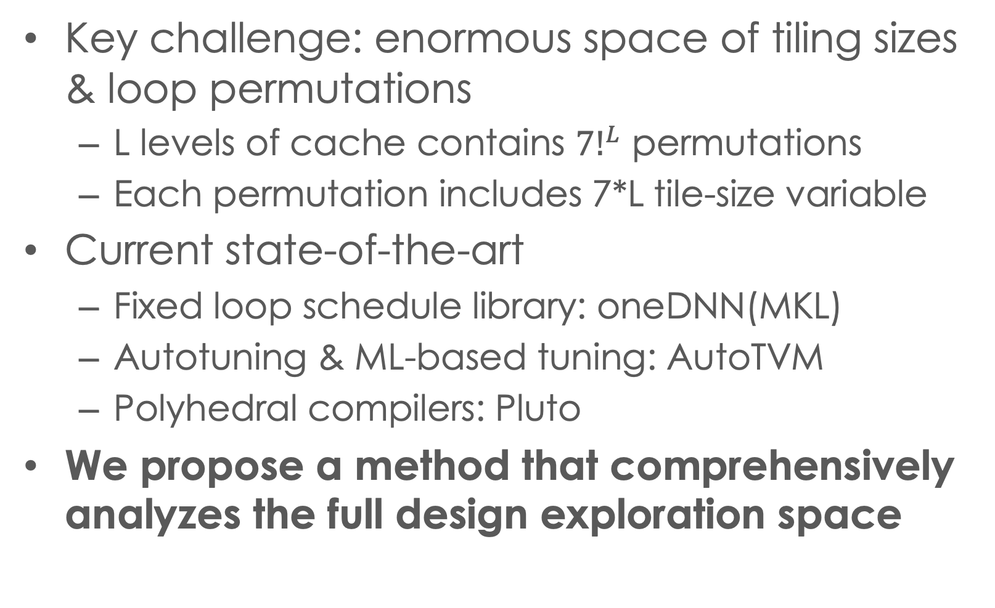
Existing work
Key challenge: enormous space of tiling sizes & loop permutations
L levels of cache contains ${7!}^{L}$ permutations
Each permutation includes 7*L tile-size variable
Current state-of-the-art
Fixed loop schedule library: oneDNN(MKL)
Autotuning & ML-based tuning: AutoTVM
Polyhedral compilers: Pluto
We propose a method that comprehensively analyzes the full design exploration space
Notes:
...
We'll intro our work by first provide an overview

Slide 34
conclusion
We proposed a new approach to find the best configuration for optimizing conv2d
We created an effective analytical modeling approach which is exploited to achieve dramatic space pruning
We demonstrate that achieved performance can be comparable to or better than state-of-the-art
Acknowledgments: This work was supported in part by the U.S. National Science Foundation through awards 1946752, 1919122 and 2018016.

